Slide 1
SIT113 Cloud Computing and Virtualisation
Week 2, Class 2
Linux

Slide 2
Outline
Linux
Graphical User Interface (GUI)
Command Line Interface (CLI)
Commands
Directories
Accounts
Ownership
Permissions

Slide 3
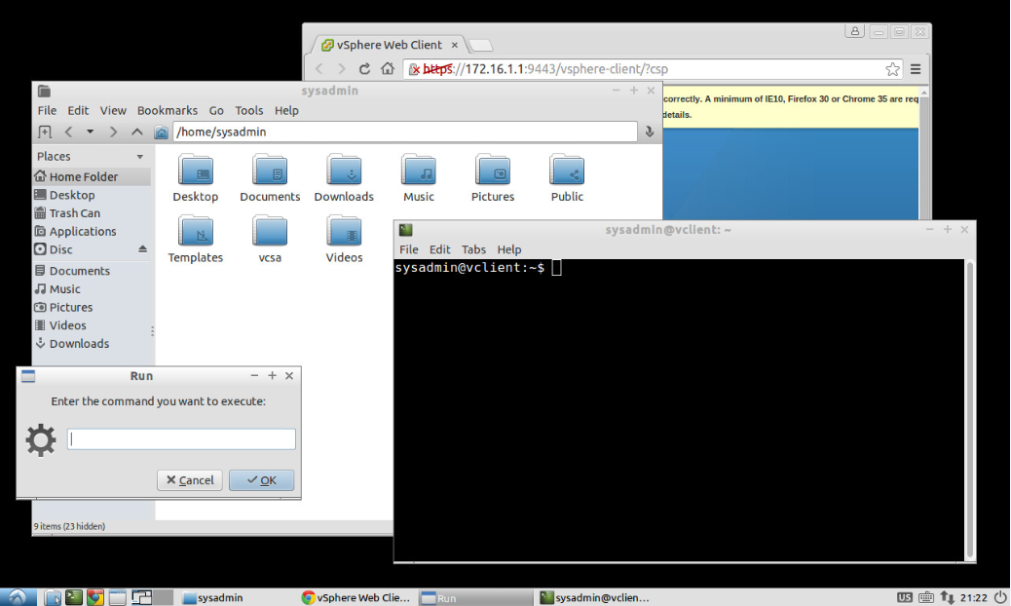
Graphical User Interface (GUI)
Windows
Icons
Menus
Images
Mouse
Cursor
Keyboard
Touch Screen

Slide 4
Command Line Interface (CLI)
A command is an instruction that tells a computer to do something.
A command line is a space on the computer screen in which commands are typed by a user.
A CLI is a program (typically called a shell) that can:
read commands,
execute commands, and
display textual output

Slide 5
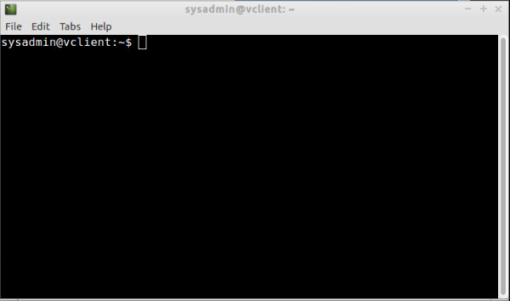
Command Line Interface (CLI)
LXTerminal
CLI is embedded in a window
User interacts with the computer via a shell

Slide 6
Command Line Interface (CLI)
Example
The lecturer can remote login to a Linux machine, (interactive.deakin.edu.au) and enter some commands. Tera Term tool can be used
Display the passwd file to show students:
The home directory such as /opt/oracle
The name of the shell such as /bin/bash

Slide 7
Commands
General format:
CommandName Parameters
Some commands and programs are:
rm – remove a file
mv – move a file to another folder
cp – copy a file
cat – concatenate one or more files

Slide 8
Commands
pwd – print the working directory/folder
cd – change directory/folder
ls – list the contents of a folder
ls -l – list information about files
mkdir – make a new folder
rmdir – remove a folder
chmod – change permissions of a file or folder

Slide 9
Commands
passwd – change your password
useradd – create a new user account
ssh – remote login and remote command execution
man – display the manual entry for a command
and many more.

Slide 10
Directories
A Linux directory is like a Windows folder.
A directory is a list of items such as files, folders, shortcuts (links).

Slide 11
Accounts
An account is required to login to a Linux system.
A Linux account normally requires the following:
username
password
UID - user identifier
GID - group identifier
Comment Field
Home Directory
Login Shell

Slide 12
Accounts: Username & Password
A user has a username, up to 32 characters.
root is the username of the admin account.
A user has a password.
The admin account (root) also has a password.

Slide 13
Accounts: UID and GID
A user has an identification number (UID).
The UID of the admin account (root) is 0.
A user has a group identification number (GID). It indicates which group that user belongs.
The GID of the admin account (root) is 0.

Slide 14
Accounts: Comment Field
A user can have a short description. For a normal user, this is typically their real name.
root can have a short description too.

Slide 15
Accounts: Home Directory
A user, such as Elisabeth Brown, has a home folder, such as /home/ebrown, in which Elisabeth can store files and other folders containing more files and folders.
Normally, the name of the home directory is the username (ebrown), and is created in /home.
Other system accounts can have different home folders. For example:
root has the home folder of /root
mail might have /var/spool/mail

Slide 16
Accounts: Login Shell
A user has a login shell which is a program.
A common shell is /bin/bash.
During the login phase, if the user credentials are valid, the operating system runs this shell to provide that user with a CLI.
The admin account (root) has a login shell too.

Slide 17
Ownership
A file has an owner, i.e., an account/user on the system, and indicated by a UID/username.
A file can be shared by a group of accounts/users, indicated by a group name.
A user can use the chmod command to change permissions of a file that they own.
a user might set permissions to share a file
a user might set permissions to stop sharing a file

Slide 18
Permissions
There are permissions on a file for:
the owner
a group of users
all users
A user has access to files/folders based on the permissions on those files/folders.
In contrast, the root account has access to all files and folders. This is why hackers try to gain root access.

Slide 19
Permissions
Example (explain all permissions):
drwxrwxr-x jack itstaff security
-rwxr----- jack itstaff analyseLogs
lrwx------ jack itstaff results.txt
-rwsr-xr-x root root at
user
group
others
username
group name
file name
Notes:
r - read
w - write
x – execute
$ ls -l
total 188
drwx------ jk users 4096 2008-10-24 11:30 cs21/
drwx------ jk users 4096 2007-10-01 12:24 mail/
drwxr-xr-x jk users 4096 2008-06-05 10:33 public/
-rw------- jk users 83623 2008-09-10 08:29 turing.pdf
-rw-r--r-- jk users 9134 2008-01-24 16:26 unix-by-example
The first column above is the file permissions (drwx------ or -rw-r--r--), the second is the owner of the files and directories (jk), and the third column is the group (users).
For the file permissions,
the first letter is either a "d" or a "-", meaning it's a directory or a file.
The next three characters (e.g., rwx) are the permissions for the owner of the file.
Then comes the group permissions (e.g., everyone in the users group), and
finally permissions for everyone else. Here are some examples:
drwx------ : directory only accessible by owner
drwxr-xr-x : directory anyone can access
-rwxr-xr-x : file anyone can read and execute
-rw-r----- : file only people in the group can read
To see what groups you are in, run the groups command.

Slide 20
r - read
w - write
x – execute
$ ls -l
total 188
drwx------ jk users 4096 2008-10-24 11:30 cs21/
drwx------ jk users 4096 2007-10-01 12:24 mail/
drwxr-xr-x jk users 4096 2008-06-05 10:33 public/
-rw------- jk users 83623 2008-09-10 08:29 turing.pdf
-rw-r--r-- jk users 9134 2008-01-24 16:26 unix-by-example
The first column above is the file permissions (drwx------ or -rw-r--r--), the second is the owner of the files and directories (jk), and the third column is the group (users).
For the file permissions,
the first letter is either a "d" or a "-", meaning it's a directory or a file.
The next three characters (e.g., rwx) are the permissions for the owner of the file.
Then comes the group permissions (e.g., everyone in the users group), and
finally permissions for everyone else. Here are some examples:
drwx------ : directory only accessible by owner
drwxr-xr-x : directory anyone can access
-rwxr-xr-x : file anyone can read and execute
-rw-r----- : file only people in the group can read
To see what groups you are in, run the groups command.
Notes:
r - read
w - write
x – execute
$ ls -l
total 188
drwx------ jk users 4096 2008-10-24 11:30 cs21/
drwx------ jk users 4096 2007-10-01 12:24 mail/
drwxr-xr-x jk users 4096 2008-06-05 10:33 public/
-rw------- jk users 83623 2008-09-10 08:29 turing.pdf
-rw-r--r-- jk users 9134 2008-01-24 16:26 unix-by-example
The first column above is the file permissions (drwx------ or -rw-r--r--), the second is the owner of the files and directories (jk), and the third column is the group (users).
For the file permissions,
the first letter is either a "d" or a "-", meaning it's a directory or a file.
The next three characters (e.g., rwx) are the permissions for the owner of the file.
Then comes the group permissions (e.g., everyone in the users group), and
finally permissions for everyone else. Here are some examples:
drwx------ : directory only accessible by owner
drwxr-xr-x : directory anyone can access
-rwxr-xr-x : file anyone can read and execute
-rw-r----- : file only people in the group can read
To see what groups you are in, run the groups command.

Slide 21
Summary
Linux
Graphical User Interface (GUI)
Command Line Interface (CLI)
Commands
Directories
Accounts
Ownership
Permissions

